Slide 1

Prediction of FOREX rates using a Hybrid System
Nathan D’Lima
Under the Guidance of
Prof. Shamsuddin S. Khan
10/11/14
Computer Department,
St. Francis Institute of Technology

Slide 2
CONTENTS
Review of Stage 1
Problem Statement
Literature survey
Proposed work
Summary
References

Slide 3
Review of Stage 1
Currency exchange is the trading of one currency against another.
Home currency – currency to convert
Foreign currency – currency to which home currency is converted
Purchase of goods via the internet where the amount to be paid may be in a foreign currency.
Major uses of Foreign Currency:
  Business trading
  Import and Export of goods
  Private trading
  Banking
  Investments

Slide 4
Review of Stage 1
Foreign currency exchange or FOReign EXchange is called FOREX
It is a global decentralized market for the trading of currencies.
The foreign exchange market determines the relative values of different currencies.
The foreign exchange market is unique because of the following characteristics:
  Its huge trading volume
  Its geographical dispersion;
  Its continuous operation: 24 hours a day except weekends
  The variety of factors that affect exchange rates;
  The low margins of relative profit compared with other markets of fixed income

Slide 5
PROBLEM STATEMENT
The main drawback of current systems is the inability to provide high accuracy rates for future predicted values. A simple neural network gives very low accuracy. The objective is to predict single day and future exchange rates using a Hybrid System with greater accuracy and to predict the rise and fall of the currency rates.

Slide 6
LITERATURE SURVEY
Reference | Currencies | Method | Training sample | Performance
Emad F, M.A. Montazeri [1] | EURUSD USDCHF | IT2FCMFNS T1FCMFNS FLIT2FNS | From 1st April 2005 to10th December 2012 |  | EURUSD | USDCHF
 |  |  |  | IT2FCMFNS | 0.00613 | 0.00582
 |  |  |  | T1FCMFNS | 0.00172 | 0.00207
 |  |  |  | FLIT2FNS | 0.00165 | 0.00101
A. Cwiok, M. Kordos [2] | (Stock Trading) | Standard BP with momentum Modified BP Variable Step Search | From 1st January 1995 to 31st December 2004 | Provides optimal buy and sell signals
B. Christina, Y. Masoud [3] | USDGBP USDEUR USDCHF | Neural Network VSSA RSSA | From 3rd January 2012 to 1st March 2013 | Basic RSSA – 60% accuracy Neural Network – 48% accuracy (SSA 67% better than NN)
V. Kodogiannis and A. Lolis [5] | USDGBP | MLP with BP RBF ARNN Elman NN AFLS | From end of 1997 to end of March 2000 |  | %Error | RMSE
 |  |  |  | MLP | 0.31 | 0.421
 |  |  |  | RBF | 0.2646 | 0.3905
 |  |  |  | ARNN | 0.2711 | 0.4021
 |  |  |  | Elman | 0.2683 | 0.4010
 |  |  |  | AFLS | 0.2514 | 0.3939
A.N. Kia, M. Fathian and M.R. Gholamian [6] | EURUSD | Single ARIMA Single MLP Single RBF Hybrid (ARIMA+MLP+RBF) | From 1st August 2001 to 31st July 2010 |  | RMSE | D-stat
 |  |  |  | ARIMA | 0.0081 | 65%
 |  |  |  | MLP | 0.0076 | 67%
 |  |  |  | RBF | 0.0085 | 59%
 |  |  |  | Hybrid | 0.0068 | 71%

Slide 7
PROPOSED WORK
Propose a new technique which uses a Multi Layer Perceptron Neural Network and with back propagation and a Hybrid System.
Apply methods used in stock market prediction to predict rise and fall of FOREX rates.
A MLP neural network with standard back propagation algorithm to determine rise and fall of exchange rates.
It takes 4 inputs and gives the trend of the market as output.

Slide 8
PROPOSED MLP ARCHITECTURE
W_{i}
W_{h}
Closing
Price
W_{o}
Rise / Fall of FOREX market
SMA
EMA
Predicted Output
ROC
Update Weights
─
Error
Actual Output
Feedforward
Feedback
Figure 1: MLP Network with Back Propagation

Slide 9
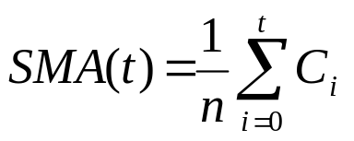
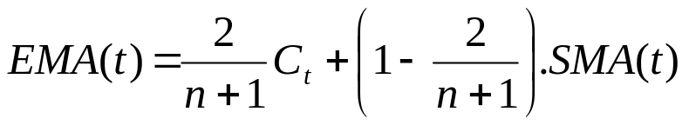
Inputs and Output
Inputs:
  Closing price : The closing price for USD v INR is taken.
  ROC: Average True Rate for the past 14 days given by-
  SMA : Simple Moving Average of the past 14 days given by –
  EMA : Exponential Moving Average given by –
Outputs:
  Trend of the FOREX Market.
(1)
(C is the closing Price)
(2)
(3)

Slide 10
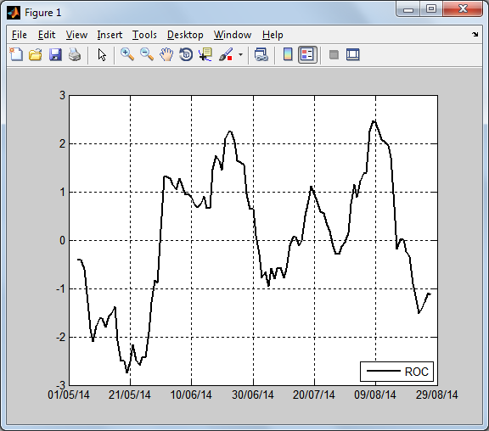
Rate of Change
Figure 2: Rate of Change

Slide 11
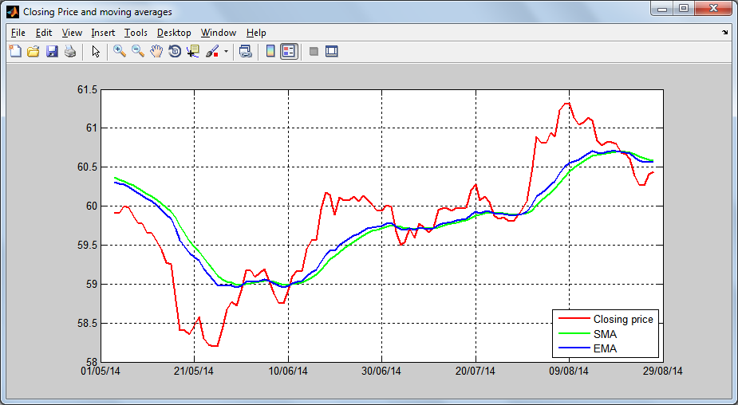
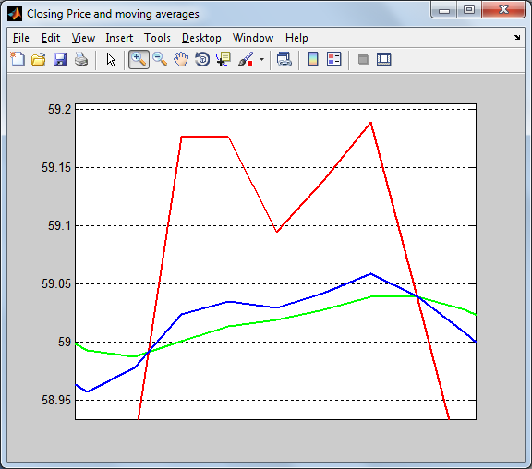
Closing Price and Moving Averages
Figure 3: Closing Price, SMA and EMA

Slide 12
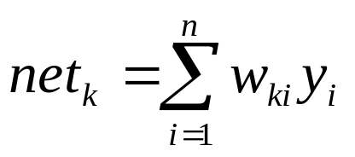
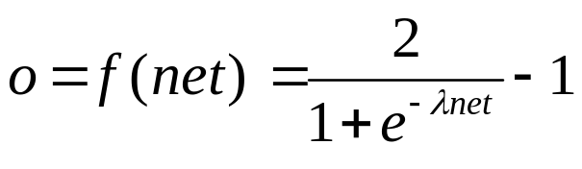
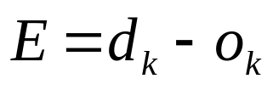
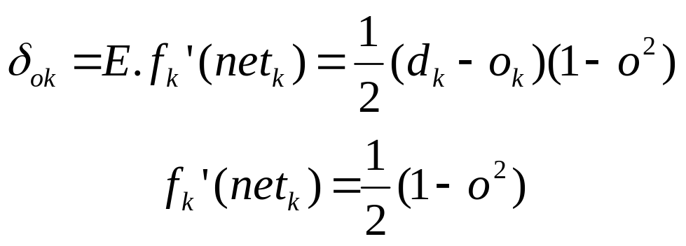
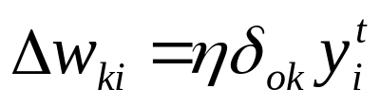
Required Formulae ^{[7]}
For input data set y and weights w –
Value of net at each node k :
Activation function at each node :
Error at output :
Weight update :
(4)
(5)
(6)
(7)
(8)
(9)

Slide 13
PROPOSED WORK
The first method uses a MLP network to predict the market trend.
The second method uses a hybrid neuro-fuzzy system to predict the FOREX rate accurately.
For this, ANFIS model is used.
It takes 2 inputs and gives the predicted exchange rate as output.

Slide 14




PROPOSED ANFIS ARCHITECTURE
A₁
Closing Rate
W₁
π
N
f₁
A₂
Predicted FOREX rate
Σ
B₁
Moving Average
π
N
f₂
W₂
B₂
Input Layer
Layer 1
Fuzzfication
Layer 2
Firing strength
Layer 3
Normalization
Layer 4
Finding consequent
Layer 5
Defuzzification and Output
Figure 4: ANFIS architecture [8]

Slide 15
Inputs and Output
Inputs:
  Closing Price : The closing price for USD v INR is taken.
  Moving Average : Simple Moving Average is used.
Output:
  Predicted FOREX Rate.

Slide 16
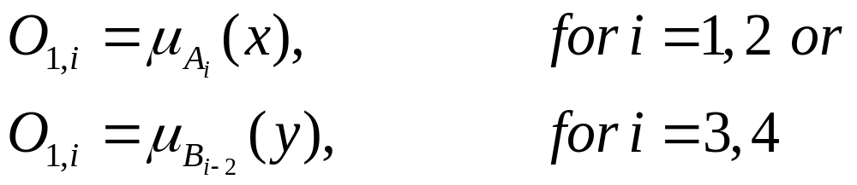
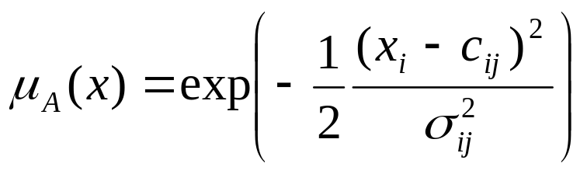
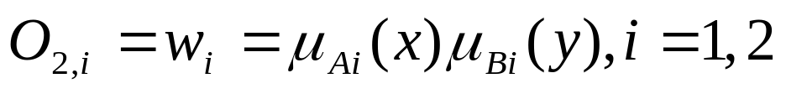
Required Formulae ^{[8]}
Layer 1 : Each node is an adaptive node with a node function –
Layer 2 : Each node is an fixed node labelled Π with output as product of all incoming signals –
(10)
(11)
(12)

Slide 17
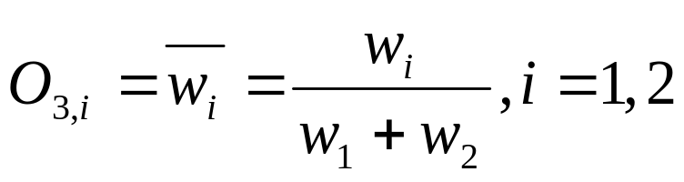
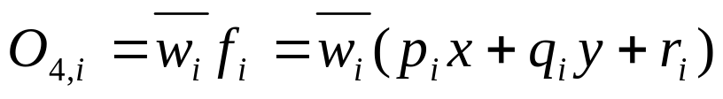
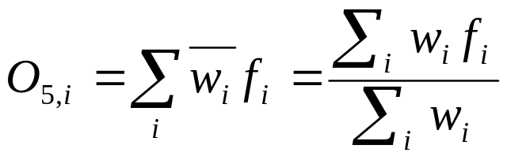
Required Formulae ^{[8]}
Layer 3 : Each node is an fixed node labelled N with ith node calculating the normalized firing strength –
Layer 4 : Every node in this layer is a fixed node labelled Σ, which computes the firing strength of the consequent parameters –
Layer 5 : It has a single fixed node labelled Σ, which computes the overall output as summation of incoming signals –
(13)
(14)
(15)

Slide 18
Summary
Forex prediction minimizes risks and maximized profits.
Prediction allows traders to use various strategies and trade various currencies to obtain maximum profit.
Hybrid Systems perform better than individual systems like NN, ARNN, RBF, etc.
Combination of MLP (to check rise and fall of market) and Hybrid System (to predict the rate) provides a more robust system.

Slide 19
REFERENCES
[1] Emad F, M.A. Montazeri, “ Forecasting Foreign Exchange Rates Using an IT2 FCM based IT2 Neuro-Fuzzy System” in 21st Iranian Conference on Electrical Engineering (ICEE), 2013.
[2] A. Cwiok, M. Kordos, “A New Approach to Neural Network Based Stock Trading Strategy”, in Intelligent Data Engineering and Automated Learning - IDEAL 2011Lecture Notes in Computer Science Volume 6936, 2011, pp 429-436.
[3] B. Christina, Y. Masoud, “FORECASTING EXCHANGE RATES: AN OPTIMAL APPROACH” in J Syst Sci Complex (2014) 27: 21–28.
[4] http://fxtrade.oanda.com/learn/technical-analysis-for-traders/ stochastic/summary

Slide 20
REFERENCES
[5] V. Kodogiannis and A. Lolis, "Prediction of foreign exchange rates by neural network and fuzzy system based techniques," in European Symposium on Artificial Neural Networks Bruges (Belgium), April 2001, pp. 245-250
[6] A.N. Kia, M. Fathian and M.R. Gholamian, “Using MLP and RBF Neural Networks to Improve the Prediction of Exchange Rate Time Series with ARIMA”, International Journal of Information and Electronics Engineering, Vol. 2, No. 4, 2012, pp. 543-546
[7] Jacek M. Zurada, Introduction to Artificial Neural Systems, West Publishing Company, 1999.
[8] J.S.R. Jang, C.T. Sun and E. Mizutani, Neuro-Fuzzy and Soft Computing – A Computational Approach to Learning and Machine Intelligence, Prentice-Hall Inc., 1997.

Slide 21
QUESTIONS?

Slide 22
THANK YOU!

